Slide 1

For Naz University
Maheswar Barrenkala

Slide 2

Agenda
Cover page (project title and team members)
Agenda
Project charter
Scope (WSB)
Schedule (Gantt chart)
Budget plan (with basis of estimate)
Quality system / test plan yes
Team roles and responsibility (RACI)
Communication plan
Risk register
Make or buy analysis
Statement of Work(SoW)
JIRA scrum board of your team project

Slide 3
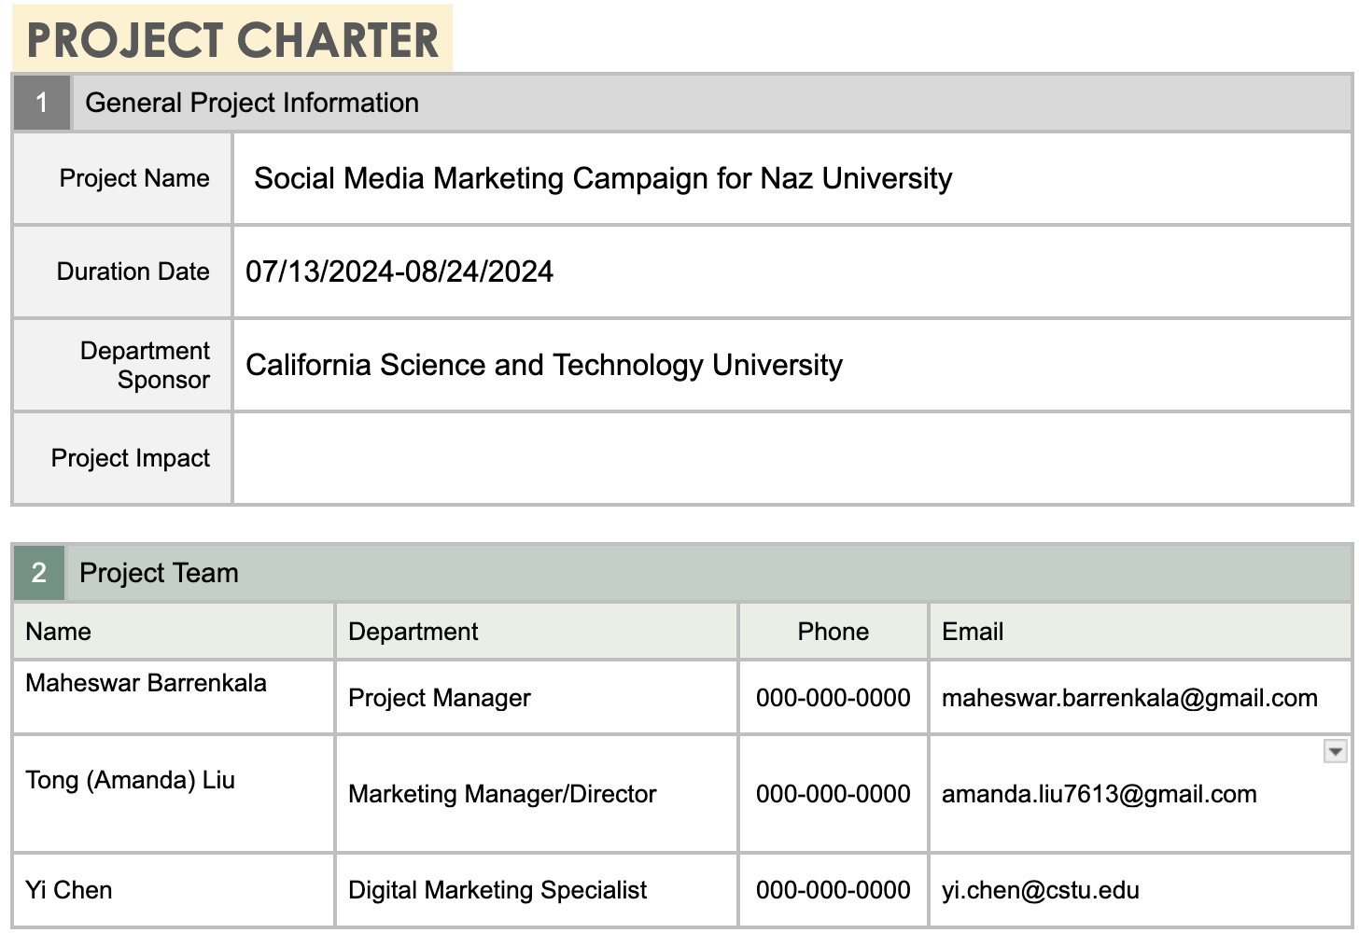
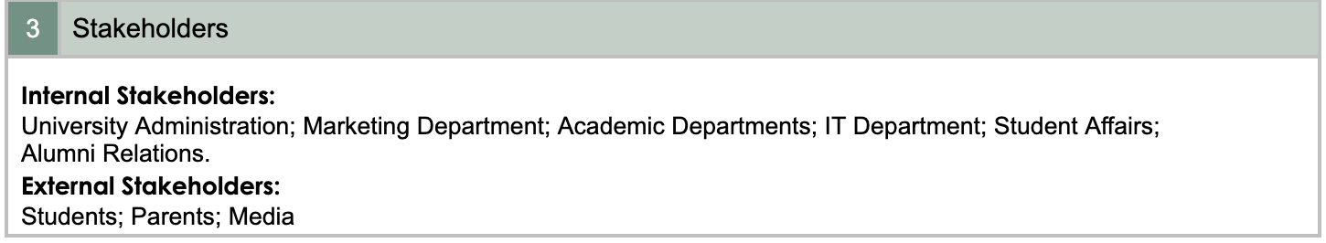
Project charter

Slide 4
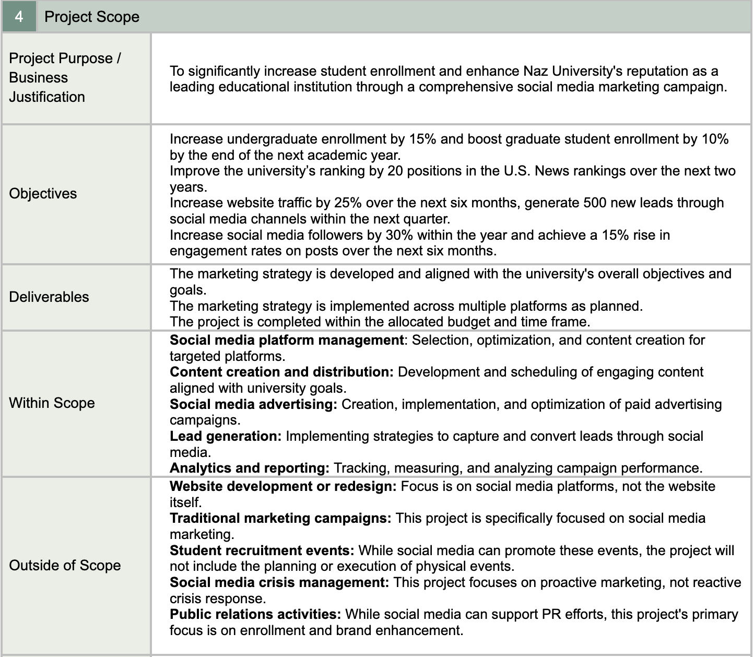

Slide 5
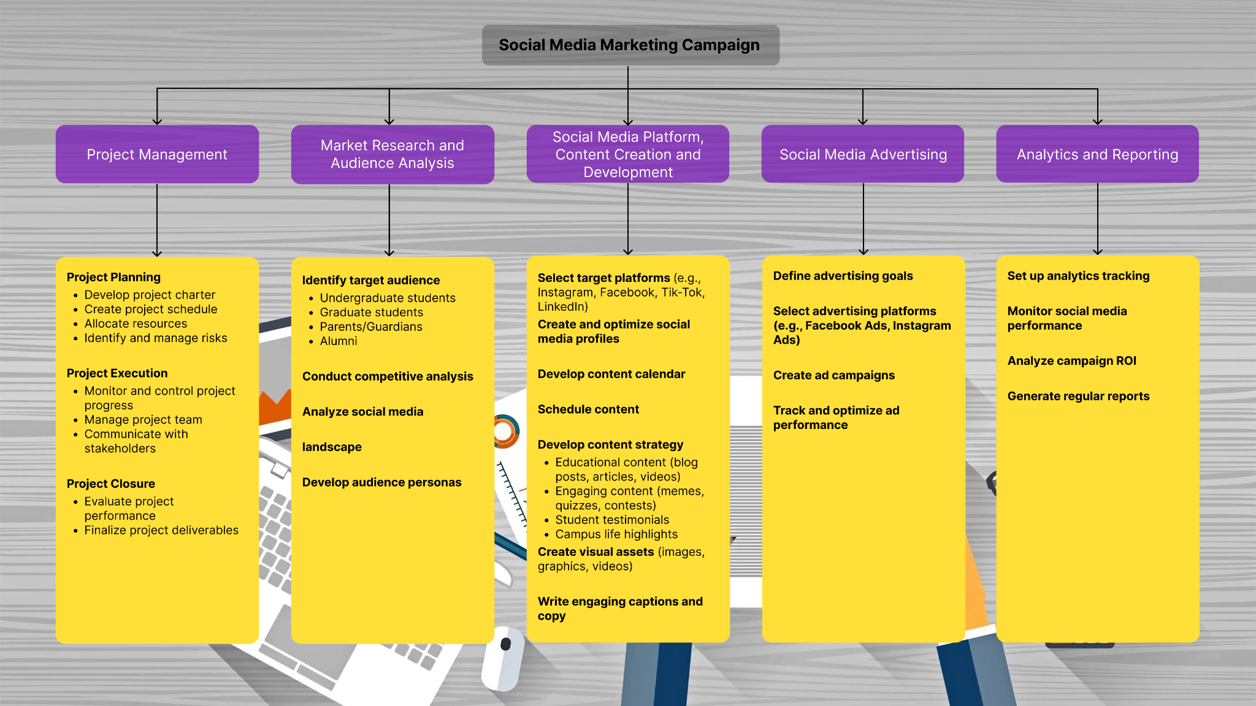
Scope(Work Breakdown Structure)

Slide 6
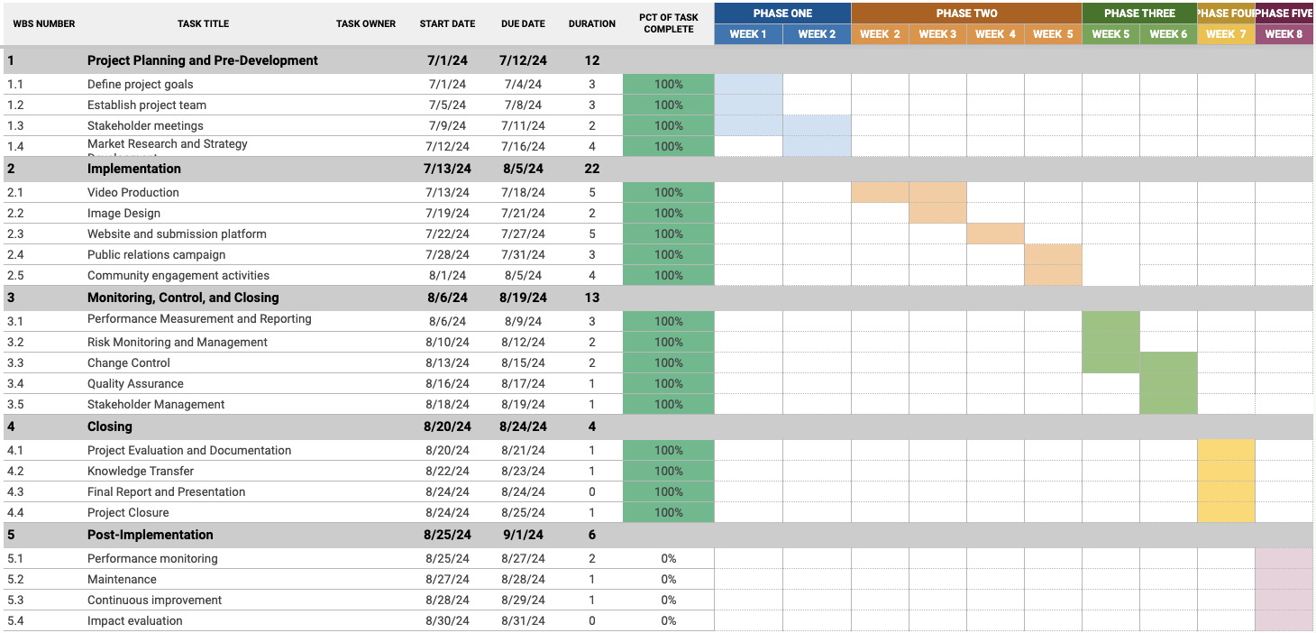
Schedule (Gantt chart)

Slide 7
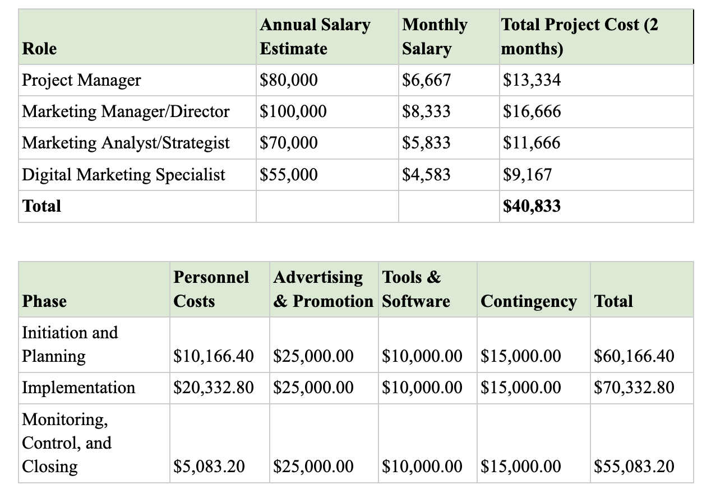
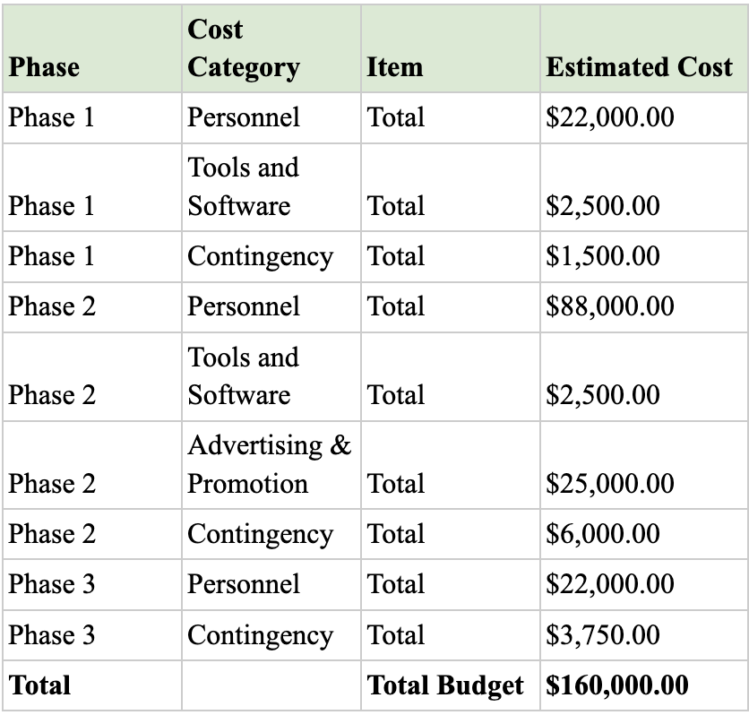
Budget Plan

Slide 8
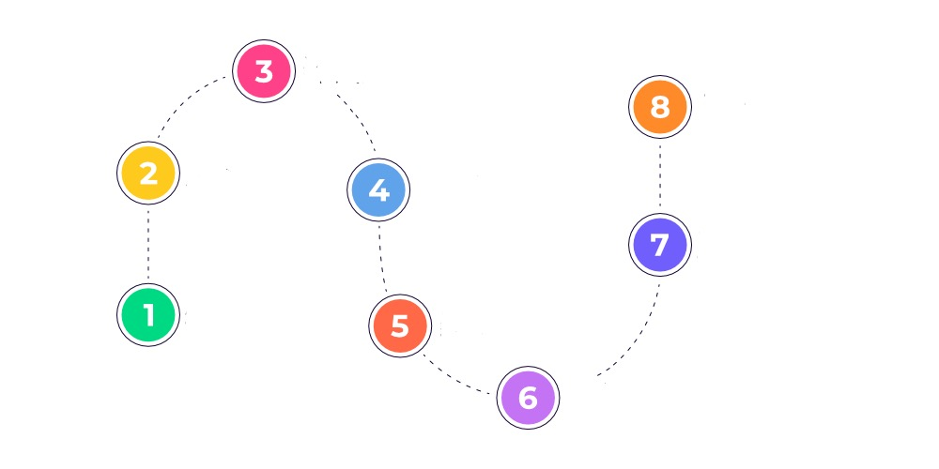
Quality System/Test Plan
10. Continual Improvement
9. Performance Evaluation
Procurement
Emergency Preparedness & Response
Construction/Implementation
Design & Development
Communication & Documentation
Testing
Project Planning
Operation & Maintenance

Slide 9
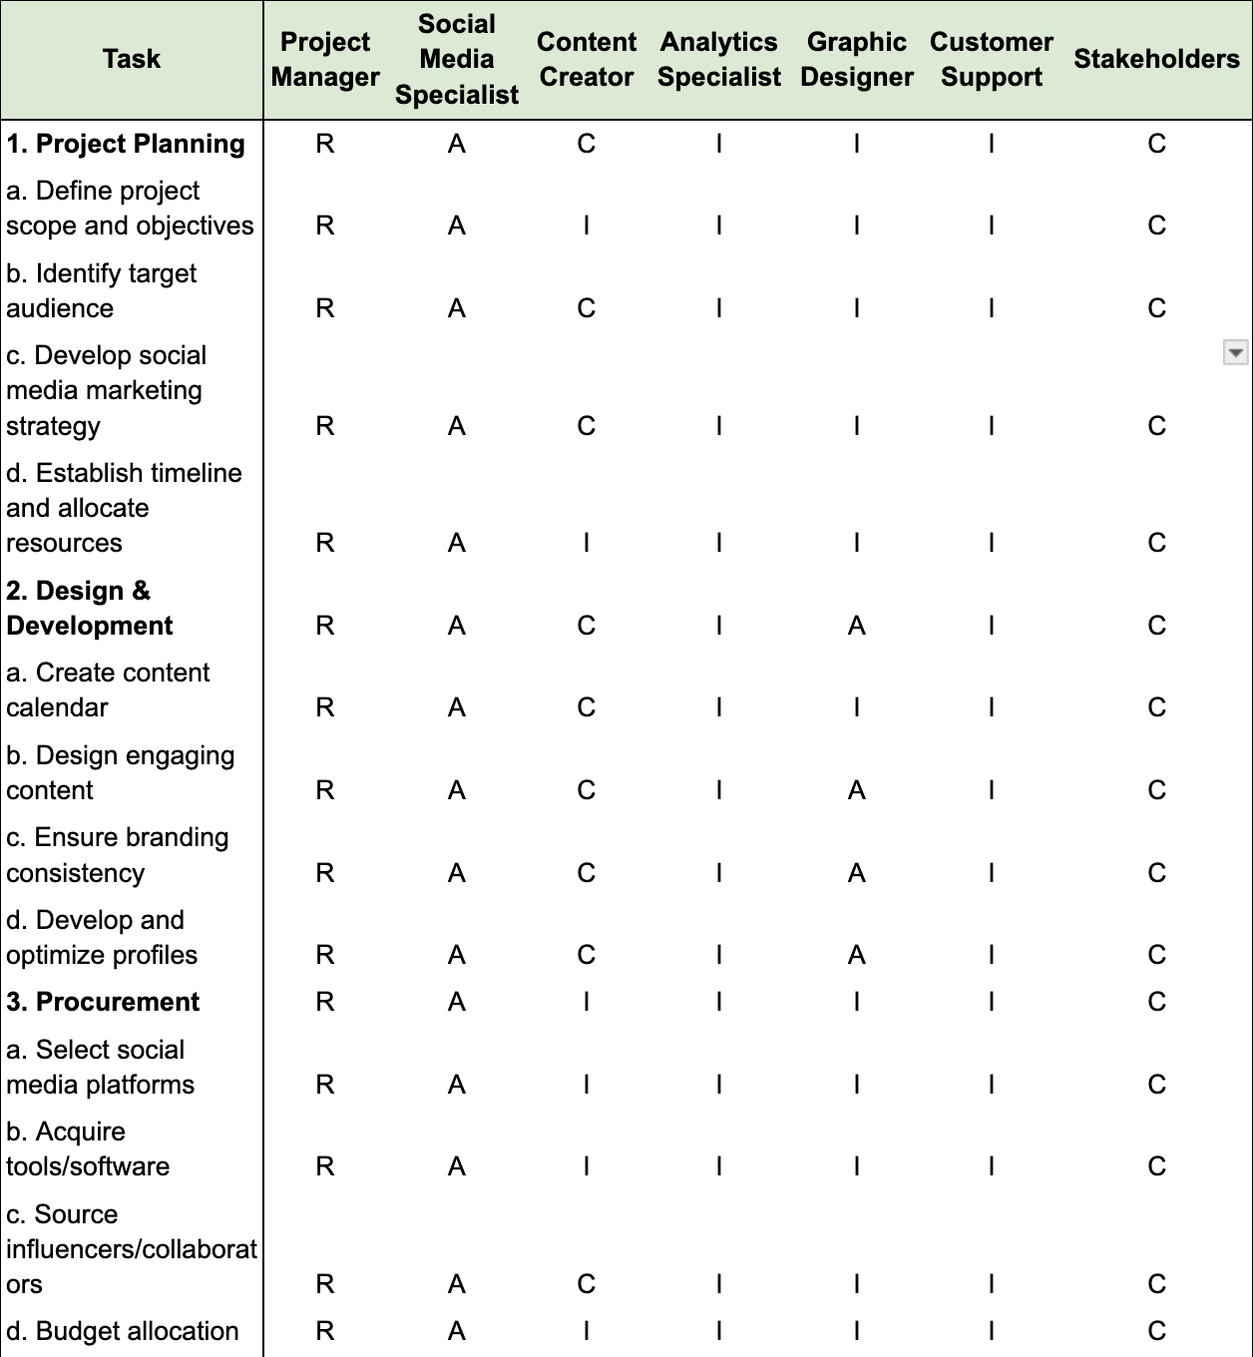
Team Roles and Responsibility(RACI)
Key Roles
1. Project Manager
2. Social Media Specialist
3. Content Creator
4. Analytics Specialist
5. Graphic Designer
6. Customer Support
7. Stakeholders

Slide 10
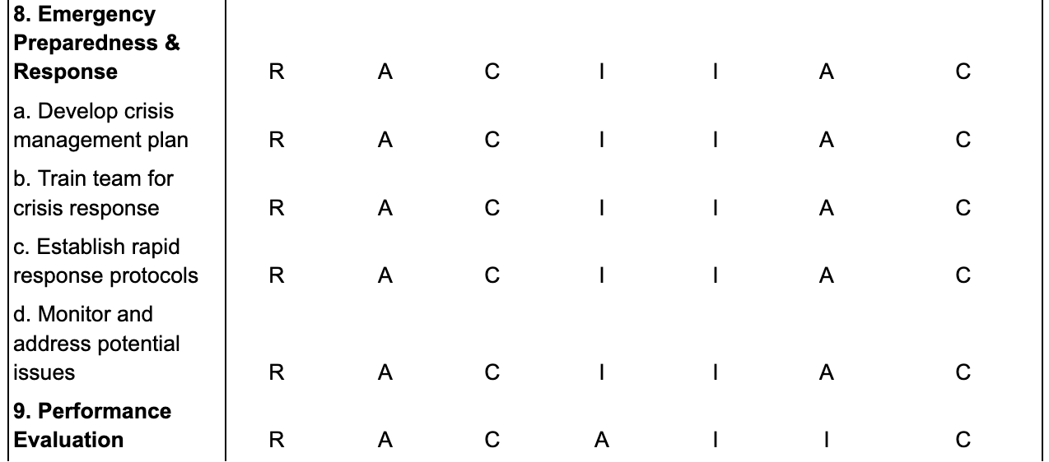
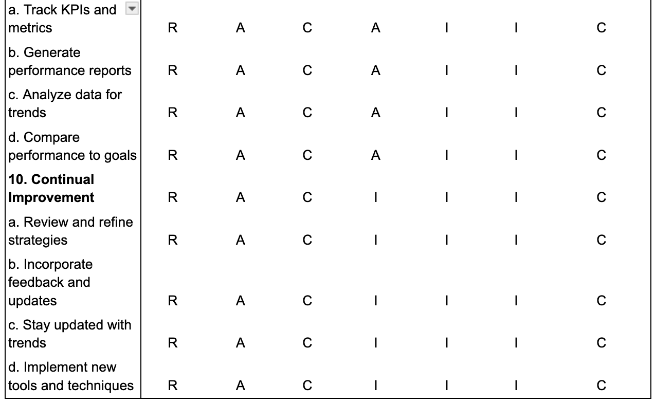
Team Roles and Responsibility(RACI)
Note: R: Responsible - The person who does the work to achieve the task.
A: Accountable - The person who is ultimately answerable for the correct and thorough completion of the task.
C: Consulted - The people who provide information for the project and with whom there is two-way communication.
I: Informed - The people who are kept informed of progress and with whom there is one-way communication.

Slide 11
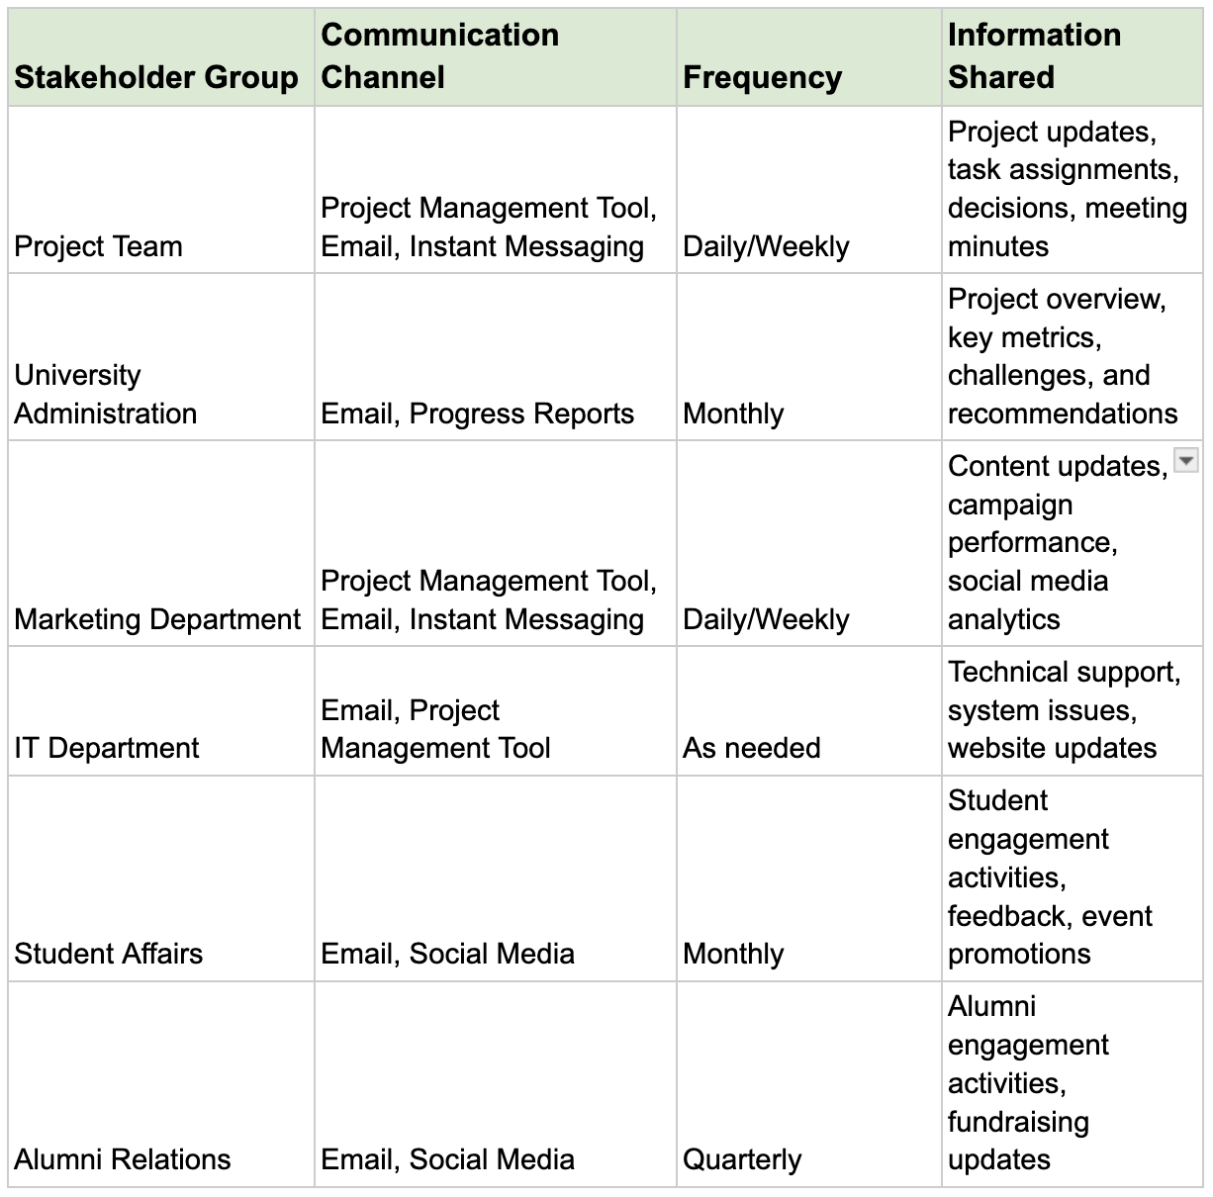
Communication Plan
Crisis Communication Plan
Identify potential crisis scenarios (e.g., negative social media comments, data breach).
Establish communication protocols for handling crises.
Designate crisis communication team members.
Develop key messages for different crisis scenarios.

Slide 12
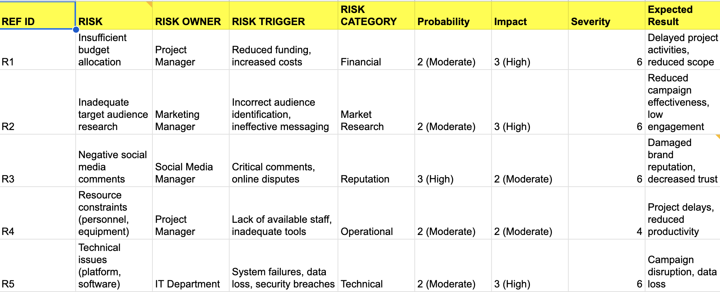
Risk Register

Slide 13

Risk Register
Risk ID: 1
Risk Description: Inadequate Audience Engagement
Impact: High
Likelihood: Moderate
Risk Mitigation: Conduct thorough market research to understand target audience preferences, and create tailored content that resonates with them. Use A/B testing to optimize posts and adjust strategy based on performance metrics.
Risk ID: 2
Risk Description: Negative Feedback or Public Relations Crisis
Impact: High
Likelihood: Low
Risk Mitigation: Develop a crisis communication plan, monitor social media channels closely for negative comments, and respond promptly and professionally. Engage a PR expert to handle severe cases and mitigate reputational damage.

Slide 14
Risk ID: 3
Risk Description: Budget Overruns
Impact: Moderate
Likelihood: Moderate
Risk Mitigation: Create a detailed budget plan with clear cost estimates for each campaign activity. Monitor spending closely and adjust plans as needed to stay within budget. Consider allocating a contingency fund for unexpected expenses.
Risk ID: 4
Risk Description: Low Return on Investment (ROI)
Impact: Moderate
Likelihood: Moderate
Risk Mitigation: Set clear, measurable goals for the campaign and track key performance indicators (KPIs) regularly. Adjust campaign strategies based on performance data and focus on high-impact, low-cost tactics to maximize ROI.

Slide 15
Risk ID: 5
Risk Description: Platform Algorithm Changes
Impact: Moderate
Likelihood: High
Risk Mitigation: Stay updated on social media platform algorithm changes by following relevant industry news and insights. Diversify content distribution across multiple platforms to reduce dependency on any single platform's algorithm.
Risk ID: 6
Risk Description: Compliance and Legal Issues
Impact: High
Likelihood: Low
Risk Mitigation: Ensure all campaign content adheres to legal and regulatory requirements, including copyright laws, privacy policies, and advertising standards. Consult legal experts if necessary, and review terms of service for each social media platform.

Slide 16
Make or Buy Analysis
Step 1: Define the Work Package
This analysis focuses on the work package of creating social media content for the Naz University marketing campaign. This includes:
Developing graphic design elements (images, videos)
Writing engaging captions and copy
Curating user-generated content
Step 2: List the Relevant Factors
Cost:
Make: Salaries for designers and content creators, software licenses, and equipment costs.
Buy: Hourly rate/package fee for external agencies, potential stock photo/video fees.
Expertise and Skills:
Make: Requires in-house design and writing skills, an understanding of the target audience.
Buy: External agencies may have specialized skills and experience in social media content creation.

Slide 17
Quality:
Make: Quality control depends on the internal team's skills and experience.
Buy: External agencies may have a proven track record of creating high-quality content.
Capacity and Resources:
Make: Consider the existing workload of design and content teams.
Buy: Frees up internal resources to focus on other project aspects.
Lead Time:
Make: Lead time depends on the internal team's availability.
Buy: External agencies may have faster turnaround times, depending on their workload.
Risk:
Make: Risk of delays due to internal resource constraints or lack of expertise.
Buy: Risk of vendor not meeting content quality expectations or adhering to project deadlines.
Long-Term Considerations:
Make: Building internal expertise can benefit future social media efforts.
Buy: Reliance on external vendors may increase long-term costs.

Slide 18
Step 3: Evaluate the Options
Make (In-House):
Suitable if Naz University has a dedicated design and content creation team with relevant skills and experience.
More cost-effective if the existing workload allows for additional content creation tasks.
Allows for greater control over brand voice and messaging consistency.
Invests in internal talent and builds expertise for future campaigns.
Buy (Outsource):
Beneficial if Naz University lacks the in-house expertise for high-quality social media content.
May be faster if external agencies have a proven track record and efficient workflow.
Frees up internal resources for other project areas like social media strategy and analytics.
Provides access to specialised skills and experience not readily available in-house.
Step 4: Make a Decision
Based on the factors considered, the decision to make or buy social media content creation will depend on Naz University's specific situation.
Step 5: Implement the Decision

Slide 19
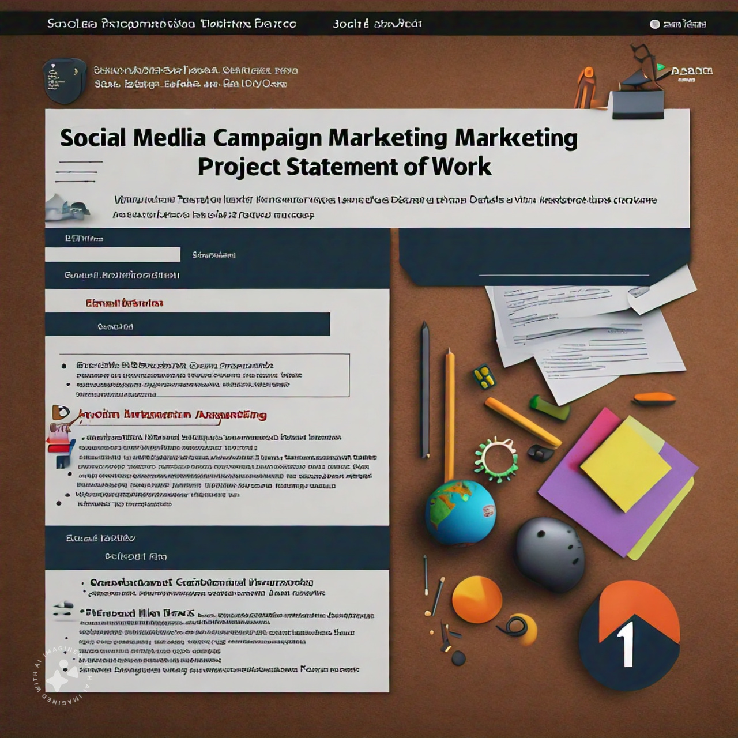
Statement of Work
1. Project Overview
This Statement of Work (SOW) outlines the scope, objectives, and deliverables of the Social Media Marketing Campaign for Naz University. The campaign aims to increase student enrollment and enhance the university's reputation through effective social media strategies.
2. Project Objectives
The primary objectives of this project are as follows:
Increase student enrollment for both undergraduate and graduate programs.
Enhance Naz University's reputation as an accredited, high-quality institution.
Drive website traffic and generate leads through effective social media campaigns.
Build a strong and engaged online community of prospective students, current students, alumni, and faculty.

Slide 20
3. Project Scope
In Scope:
Social media platform management (selection, optimization, content creation)
Content creation and distribution (development and scheduling of engaging content)
Social media advertising (creation, implementation, and optimization)
Lead generation (capturing and converting leads through social media)
Analytics and reporting (tracking, measuring, and analyzing campaign performance)
Out of Scope:
Website development or redesign
Traditional marketing campaigns
Student recruitment events (planning and execution)
Social media crisis management
Public relations activities

Slide 21
4. Key Milestones
The following milestones have been established for the project:
Milestone 1: Social media platform selection and optimization
Milestone 2: Content creation and scheduling
Milestone 3: Social media advertising campaign launch
Milestone 4: Lead generation strategy implementation
Milestone 5: Campaign performance analysis and reporting
5. Budget Estimate
The estimated budget for this project is $160,000, distributed as follows:
Personnel Costs: $110,000
Advertising and Promotion: $25,000
Tools and Software: $10,000
Contingency: $15,000
6. Project Team
The project team includes key roles responsible for project execution:
Project Manager: Maheswar Barrenkala
Marketing Manager/Director: Tong (Amanda) Liu
Digital Marketing Specialist: Yi Chen
7. Key Stakeholders
Key stakeholders for this project include:
University Administration (President, Provost, Deans, Department Heads)
Marketing Department (Marketing Director, Marketing Managers, Team Members)
Academic Departments (Faculty, Program Coordinators)
IT Department
Student Affairs
Alumni Relations
Students (current and prospective)
Parents/Guardians
Alumni
Donors
Community Members
Media
8. Risks
Potential risks associated with this project include:
Insufficient budget allocation
Inadequate target audience research
Negative social media comments

Slide 22
9. Approval Signatures
Project Sponsor: Naz University Project Manager: Maheswar Barrenkala, Tong (Amanda) Liu, Yi Chen
10. Review and Acceptance Criteria
The project will be considered a success if:
The marketing strategy aligns with the university's objectives. - increase application amount 10%
The marketing campaign is implemented as planned.
The project is completed within the allocated budget and timeframe.
Key Performance Indicators (KPIs) are achieved or exceeded.
There is a measurable increase in target audience engagement and awareness. - Follower increased 20% before campaign
The marketing efforts contribute to achieving the university's enrollment goals.- increase application amount 10% , enrollment increase accordingly.
Stakeholders are satisfied with the project outcomes.

Slide 23
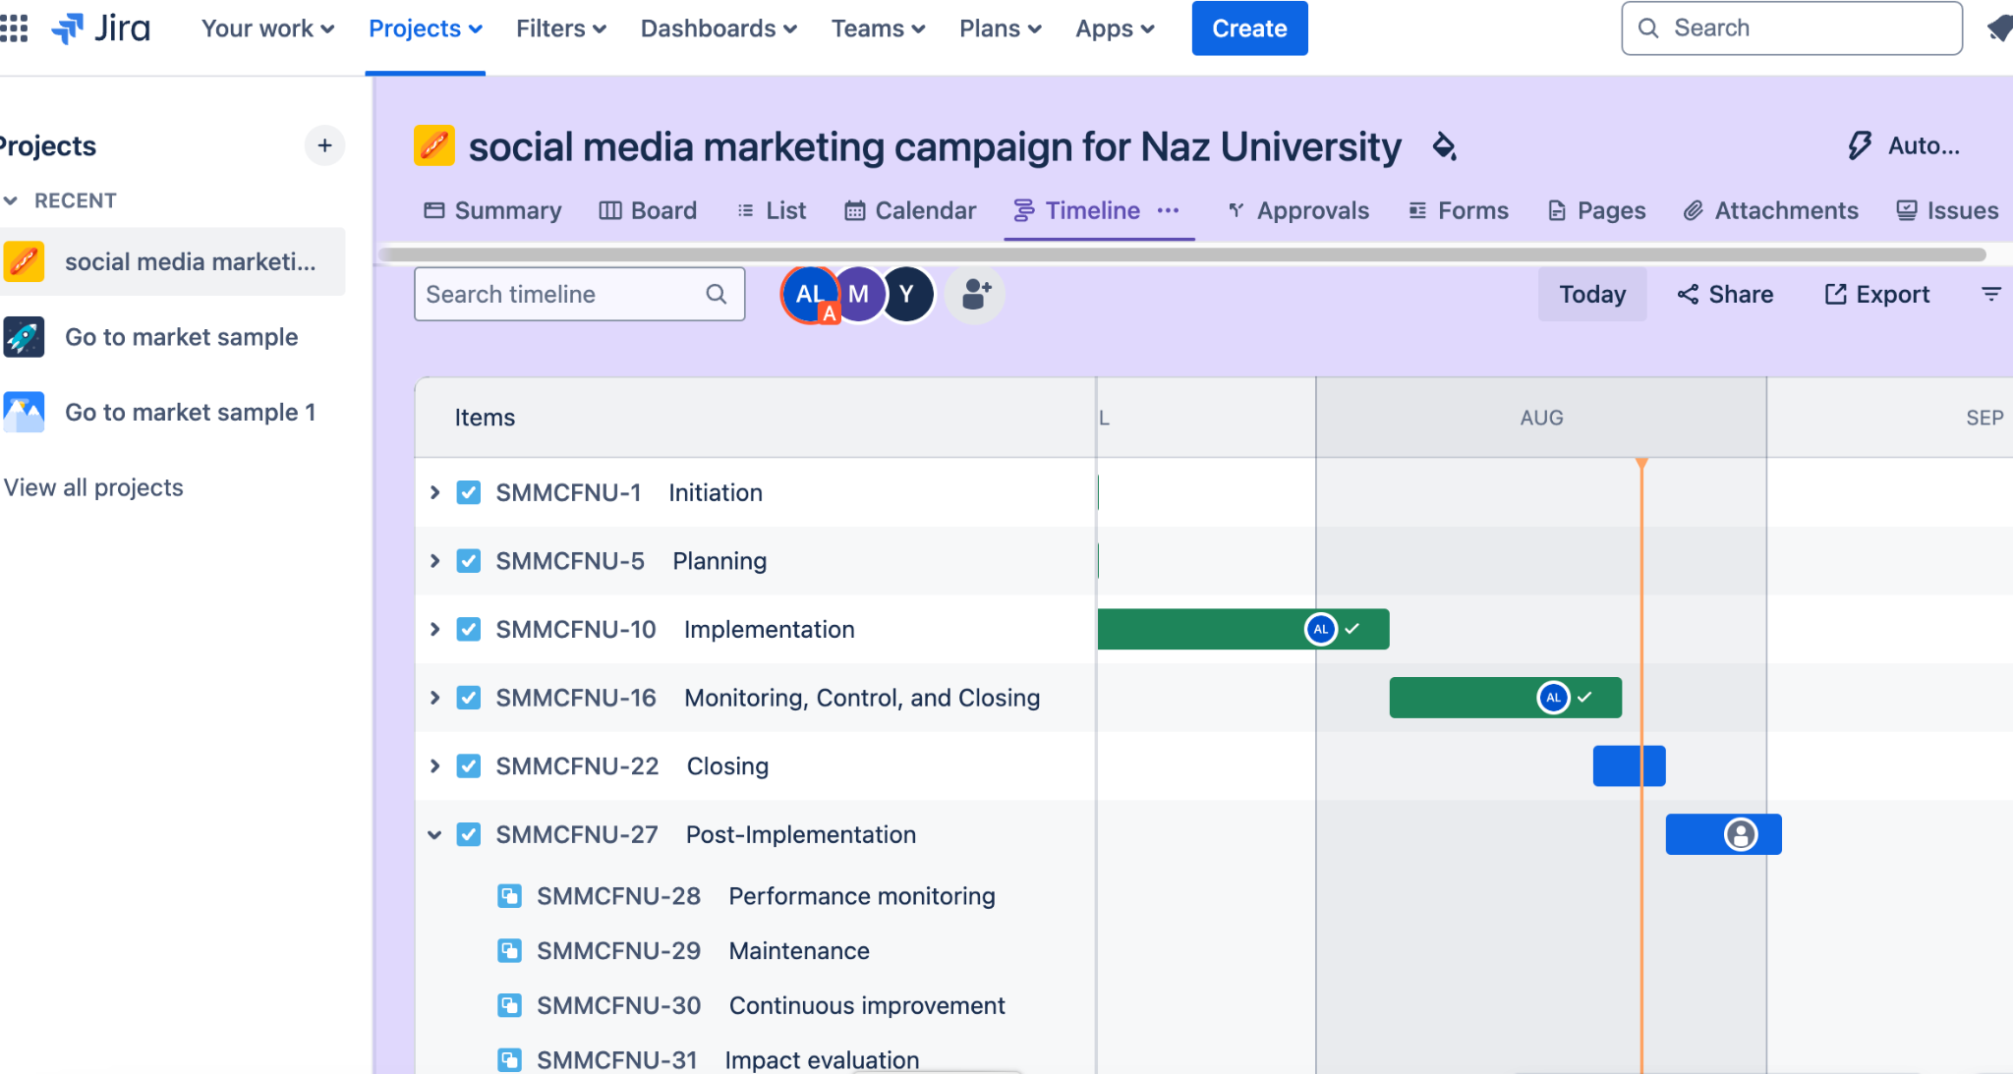
JIRA Scrum Board

Slide 24

Thank You

